Slide 1
Rabelais and the Humanist Evangelistes
Alan Haffa

Slide 2
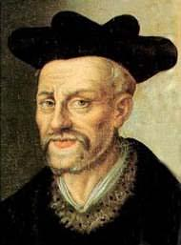
Biography
Francois Rabelais (1490?-1553)
Franciscan Monk; left order when forbidden to study Greek; Joined the Benedictines with Papal Dispensation from Clement VII
1530, studied medicine
Head Physician at hospital in Lyons
Had a child who died young
1536, Paul III absolved him and allowed him to practice medicine

Slide 3
Gargantua and Pantagruel
Pantagruel, 1532
Gargantua, 1534
Le Tiers Livre (third book), 1546
Le Quartieme Livre (fourth book) 1552
Le Cinquieme Livre (fifth book) posthumously, 1561

Slide 4
La Bruyere on Rabelais’ Writing
‘Marot and Rabelais are inexcusable in their habit of scattering filth about their writings. Both of them had genius enough and wit enough to do without any such expedient, even for the amusement of those persons who look more to the laugh to be got out of a book than to what is admirable in it. Rabelais especially is incomprehensible. His book is an enigma,—one may say inexplicable. It is a Chimera; it is like the face of a lovely woman with the feet and the tail of a reptile, or of some creature still more loathsome. It is a monstrous confusion of fine and rare morality with filthy corruption. Where it is bad, it goes beyond the worst; it is the delight of the basest of men. Where it is good, it reaches the exquisite, the very best; it ministers to the most delicate tastes.’

Slide 5
Encyclopedic in Scope
Mikhail Bakhtin considered it the first Novel
Novel is about Challenging Social
“Carnivalesque” is also seen in the Grotesque, the Scatalogical and the Excess of the novel
Polyglossia versus Monoglossia
Complex world view, not simple; Connected with the Present more than the Past
Genre is unique and impossible to categorize; L’histoire or Chronique (History and Chronicle) and mock Epic.

Slide 6
Evangelistes
Erasmus, Thomas More, and Rabelais,
Christian Humanism: belief that to be truly Christian meant to try and live in a Christ-like manner; to show charity and love to your neighbor
Translating and Disseminating the Bible.
NOT Schismatics, but reformers
After the Reformation began, the Evangelistes themselves were critical of the Protestant Reformation and Luther

Slide 7
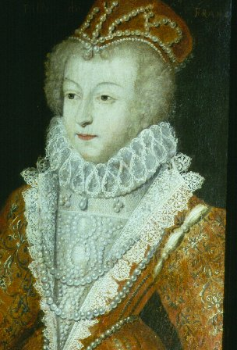
Rabelais’ Patrons
Cardinal DuBellay: a close advisor to Francis I and a supporter of the Evangelistes and Humanists
Marguerite de Navarre: Sister of Francis I and a supporter of Rabelais and other Humanists; author of the Heptameron.
Condemned by the Sorbonne, 1534

Slide 8
Prologue
Alcibiades calls Socrates a “Silenus”; a silenus is a box used to store precious drugs and ointments
Socrates was ugly outside but beautiful inside and full of “divine wisdom” “A monk’s robes hardly determine who the monk is.”
Metaphor of a Dog sucking the marrow out of bone: the book as the bone and the reader as the dog
Homer and allegory.
After inviting the reader to read deeply he scorns such a reading: “some scabby beggar said the same thing about my books, but shit to him! But the bouquet of good wine—ah, how sweet, near—what a happy treat, incredibly more delicious, more heavenly than oil”
Concludes with the main principle of the Evangelistes: “Interpret everything I do and say in the most gracious light; show proper respect for this cheesy brain, which pleases you with all this charming nonsense…”

Slide 9
Gargantua’s Genealogy
Recalls the genealogies of the Bible and Homer
Challenges traditional ideas of Class (Remember the threat of the Peasants)
“ I suspect I might be descended from some rich king or prince of olden times—because you’ll never see anyone who’d rather be a king, and rich, than me, so I could spread good cheer everywhere, and never work…and pour down gold on my friends and all good and learned men.”

Slide 10
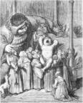
Gargantua’s Supernatural Birth
Feast, 364,014 Oxen slaughtered and Gargamelle, his mother, ate so much tripe, “her intestines fell out… Gargantua was born from her ear.
Strange Birth and Christ
Response to Sorbonne’s Definition of Faith: “An Argument for things which no one can prove.”

Slide 11
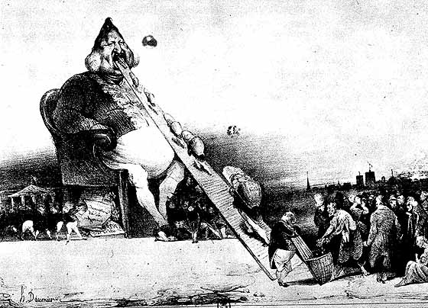
Gargantua’s Name
His first words were “Drink, drink, drink”
Father said “What a grand gargler you’ve got”
To pacify the baby they give him something to drink and baptize him and name him
Example of Cornucopia: His mother could pump out milk to fill 1402 casks…

Slide 12
Love: Caritas, Agape
Hat, with a emblem that says in Greek, “Charity Does not Seek its own Reward”
Inscribed on it is a figure of Plato’s Lover’s from the Symposium; “two-headed human body, the heads turned to face each other, and four arms, four feet, and two pairs of buttocks…”
Love is the central idea of the Evangelistes

Slide 13
Scatological
“Arse Wipes” Chapter
When Gargantua peed on Paris and drowned some of the people by accident’ Called Pa-ris “for a joke” afterwards
Took the bells of Notre Dame as cow bells for his Horse; The faculty of the Sorbonne are sent to argue for the return of the Bells (satire of Scholastic argumentation)

Slide 14
Abbey de Theleme (Desire)
Anti-Abby: No Walls; No Hours (clocks or sundials are forbidden)
Beautiful, handsome, and cheerful men AND women to be allowed only (in contrast to the typical nuns and monks)
Come and Go as you like
Marriage, money, and freedom in contrast to vows of chastity, poverty, and obedience
Only rule: “Do what you Will”: “because free men and women, wellborn, well taught, finding themselves joined with other respectable people, are instinctively impelled to do virtuous things and avoid vice…”

Slide 15
Epistelmological Uncertainty
Impossible to pin down the “meaning” of Rabelais on anything
Yet, the problem of translation, interpretation and Faith are central to the concerns of Evangelistes Reformers
End of Gargantua: Prophetic Inscription found in Foundations of Abbey de Theleme: Gargantua claims it refers “the Nature of divine truth and how to preserve it.” Friar John, “That’s not how I take it…as far as I’m concerned, all we’ve been reading is a description of a game of tennis, written in an obscure language.”
Reading and Understanding the Bible; the inscription; the text of Gargantua itself; all three are problematic.

